Slide 1

Denis Office Supplies and Furnishings
(A SQL Case Study)
Facilitator: Toyin Ademarati

Slide 2
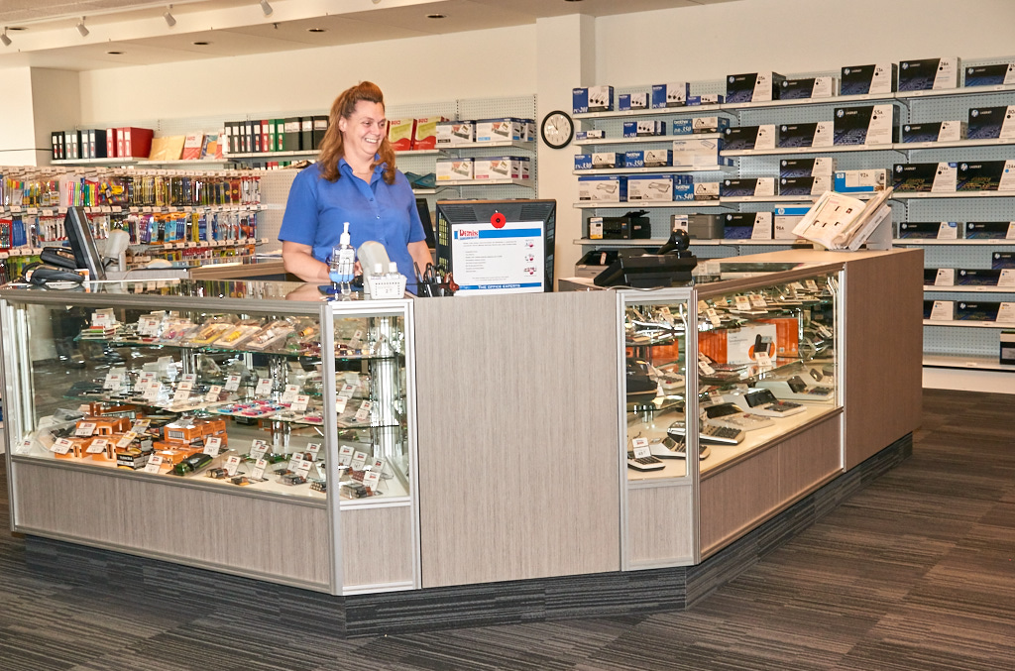
About Case Study
Denis sells office supplies, furnishings, maintenance and housekeeping equipments, and public area items to various properties in different cities in the U.S.A.
He has employed you as a data analyst to help him understand how his business has performed over time. He has provided you with data in a sql file.
You will need to extract only data that is relevant to the analysis you are to do.

Slide 3
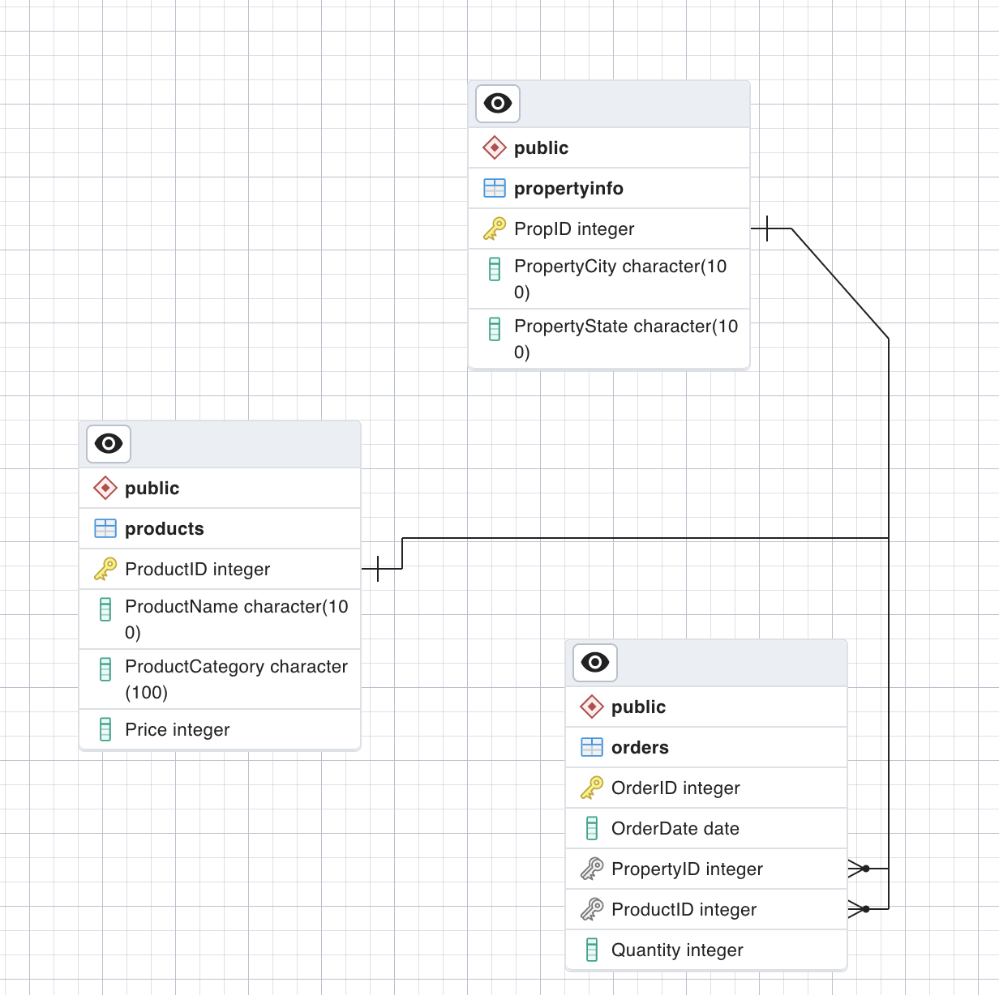
Data Dictionary
Orders Table
OrderID
OrderDate
PropertyID
ProductID
Quantity
Products Table
ProductID
ProductName
ProductCategory
Price
PropertyInfo Table
PropID
PropertyCity
PropertyState

Slide 4
Task 1
Download the dataset by clicking here
Extract the zipped file
In PgAdmin, create a new database and name it Denis_DB
Import the dataset you downloaded in the Denis_DB database.

Slide 5
Task 2
Extract the following information from Denis_DB:
Show all details about properties, orders and products.
Select the city and state column in propertyinfo table.
Find the dates orders were made and the quantity of orders made.
Find unique dates orders were made
The different product category Denis has in his store
The data from order table and sort in ascending order of quantity
All products and their details and sort in descending order of price
Find the five most expensive products

Slide 6
The name of product whose id is 50
The name and category of product whose id is 94
The name and category of product whose prices are above $200
The name of product whose prices are between $50 and $200
The productid of products sold between 07-01-2015 and 10-01-2015
Orders by property 14, 16, and 10
Total amount all products will be worth if there were just 2 of it in the store
The most expensive product
The least expensive product
What is the average price of products?
What products have names starting with “T”?

Slide 7
Take Home Task
Extract the following information from Denis_DB:
Find the different properties that have made orders.
Find the five least expensive products
All properties in alphabetical order of their city names.
The name and category of the most expensive product
The name and category of product whose price is $300
Orders by properties that are not 14, 16, and 10
Total amount all products will be worth if there were just 5 of it in the store

Slide 8
What is the most purchased product?
What is the least purchased product?
What is the average price of products for each product category?
How many products are soaps?
What is the average price of envelopes?
What is the cheapest envelope?
We want to find the the average price of housekeeping products.

Slide 9


